Slide 1
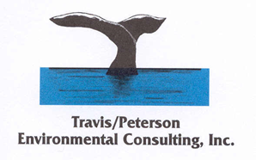
Erosion and Sediment Control Lessons Learned: Final Stabilization
Some Things to Keep in mind during design
Doubling the slope length increases erosion potential by four times
Doubling the slope gradient increases erosion potential by five times
Following construction all surfaces must be final stabilized
Built environment
Fractured rock
Vegetation
USDA maximum recommended slope where mowing is anticipated is 20%.
Beyond 3h:1v consider using engineered soil retention structures to hold topsoil on embankments.
Low erodible soils

Slide 2
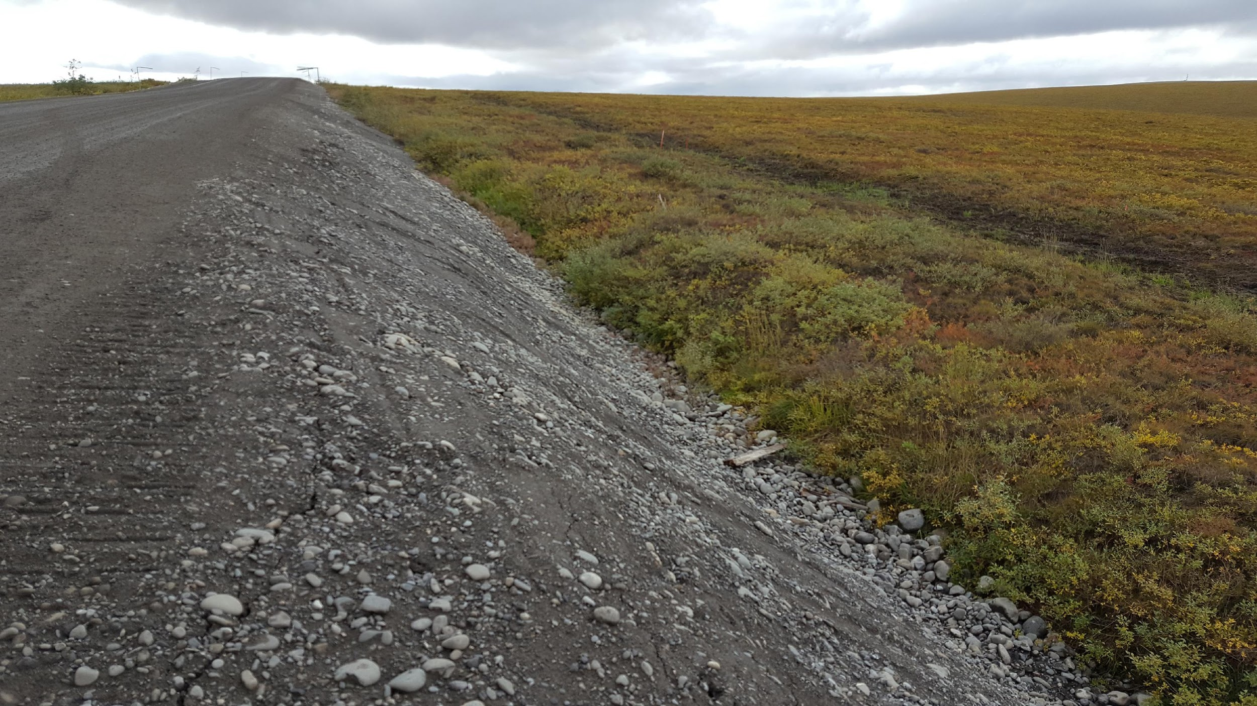
Erosion and Sediment Control: Lessons Learned: Vegetation

Slide 3
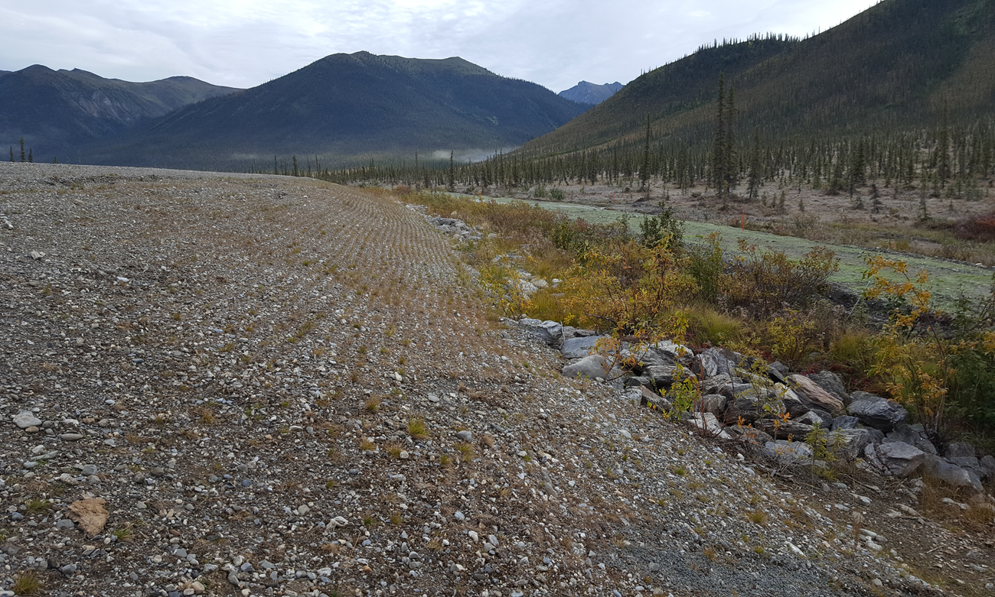
Erosion and Sediment Control: Lessons Learned: Vegetation

Slide 4
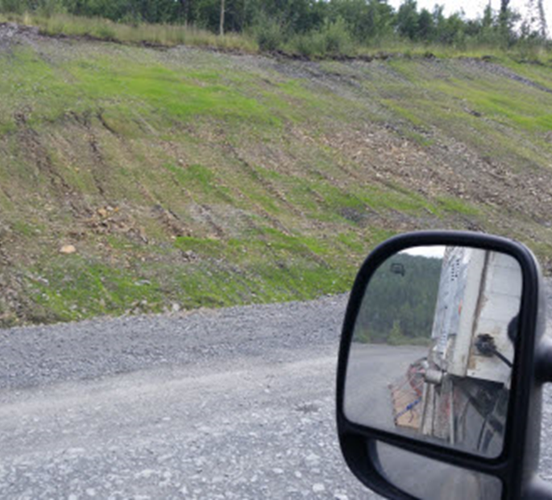
Erosion and Sediment Control: Lessons Learned: BMP Selection

Slide 5
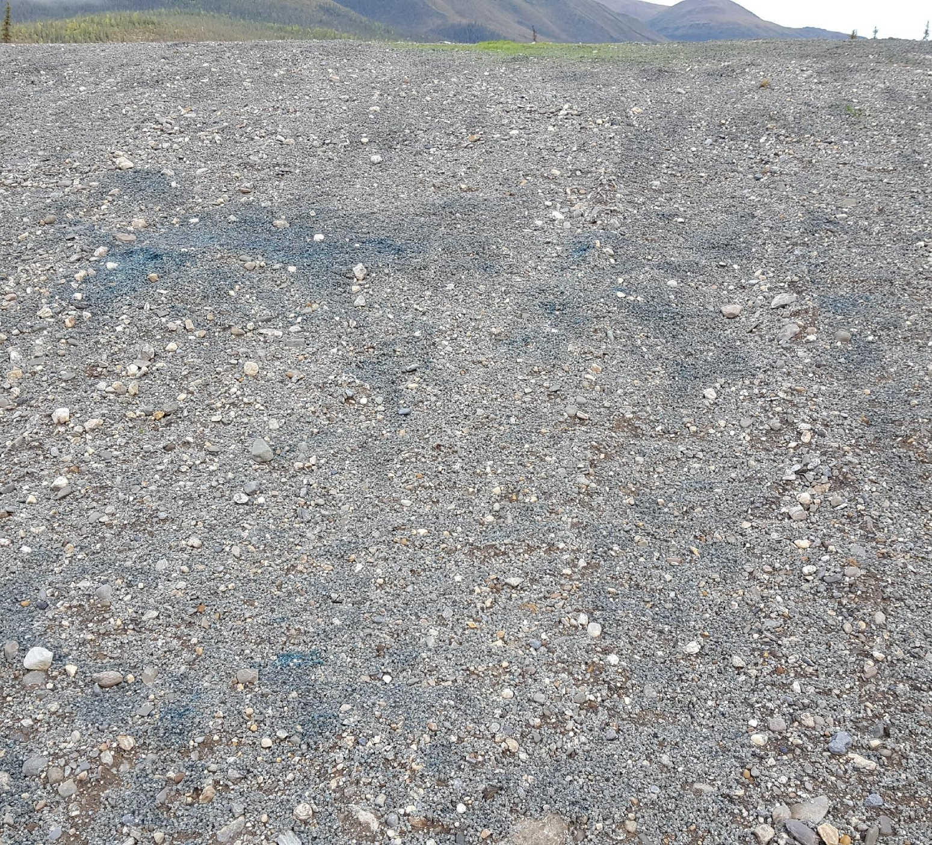
Erosion and Sediment Control: Lessons Learned: Vegetation

Slide 6
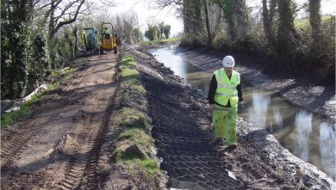
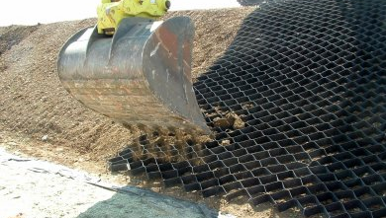
Erosion and Sediment Control: Lessons Learned: BMP Selection photos http://www.typargeosynthetics.com/products/geocells/

Slide 7
Erosion and Sediment Control: Lessons Learned: Vegetation

Slide 8
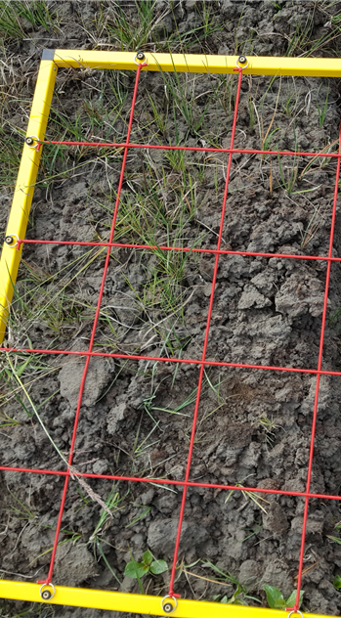
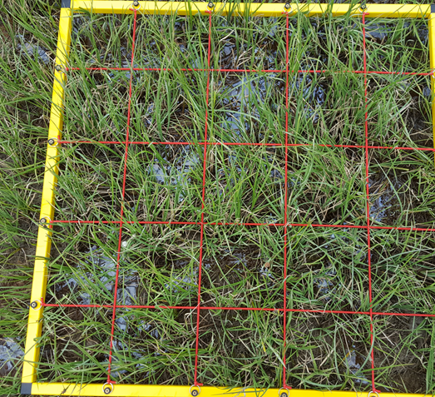
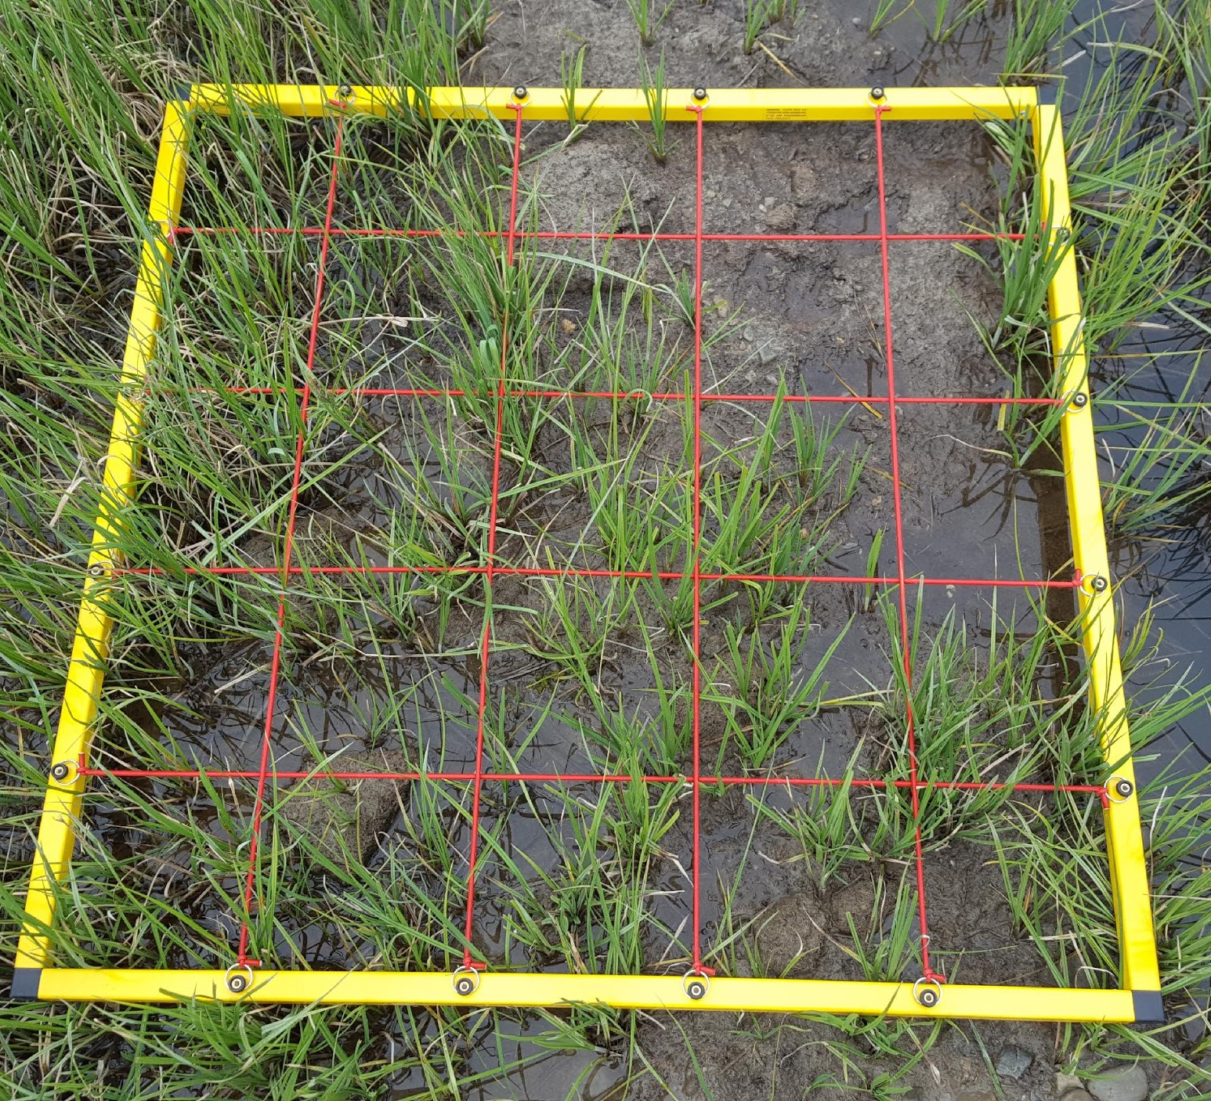
Erosion and Sediment Control: Lessons Learned: 70 Percent Uniform Cover

Slide 9
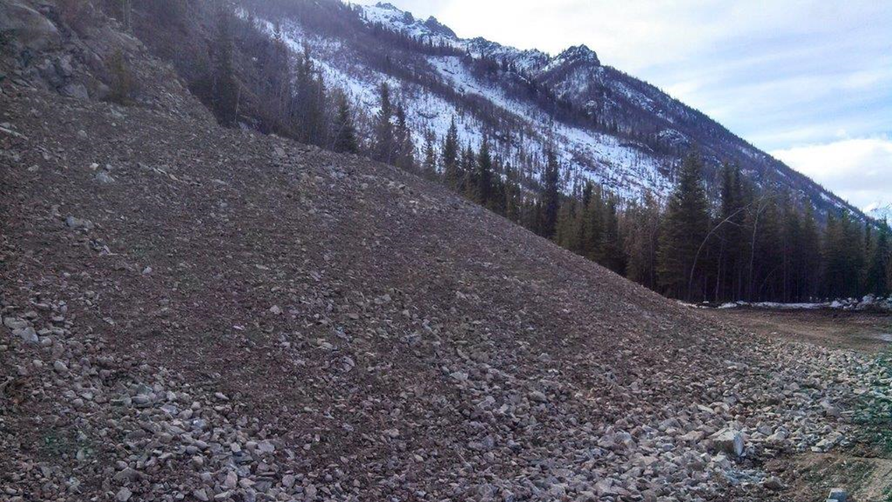
Erosion and Sediment Control: Lessons Learned:
Low Erodible

Slide 10
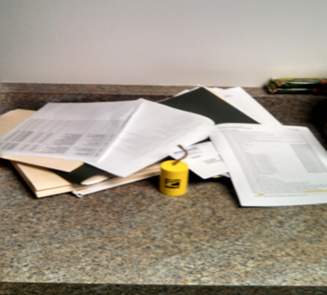
Erosion and Sediment Control Lessons Learned: Paperwork
80% of violations under NPDES/APDES are for incomplete or missing paperwork
Inspection records
Grading/stabilization logs
Corrective action logs
SWPPP Amendment Logs
SWPPP Modification Logs
Weather Records

Slide 11
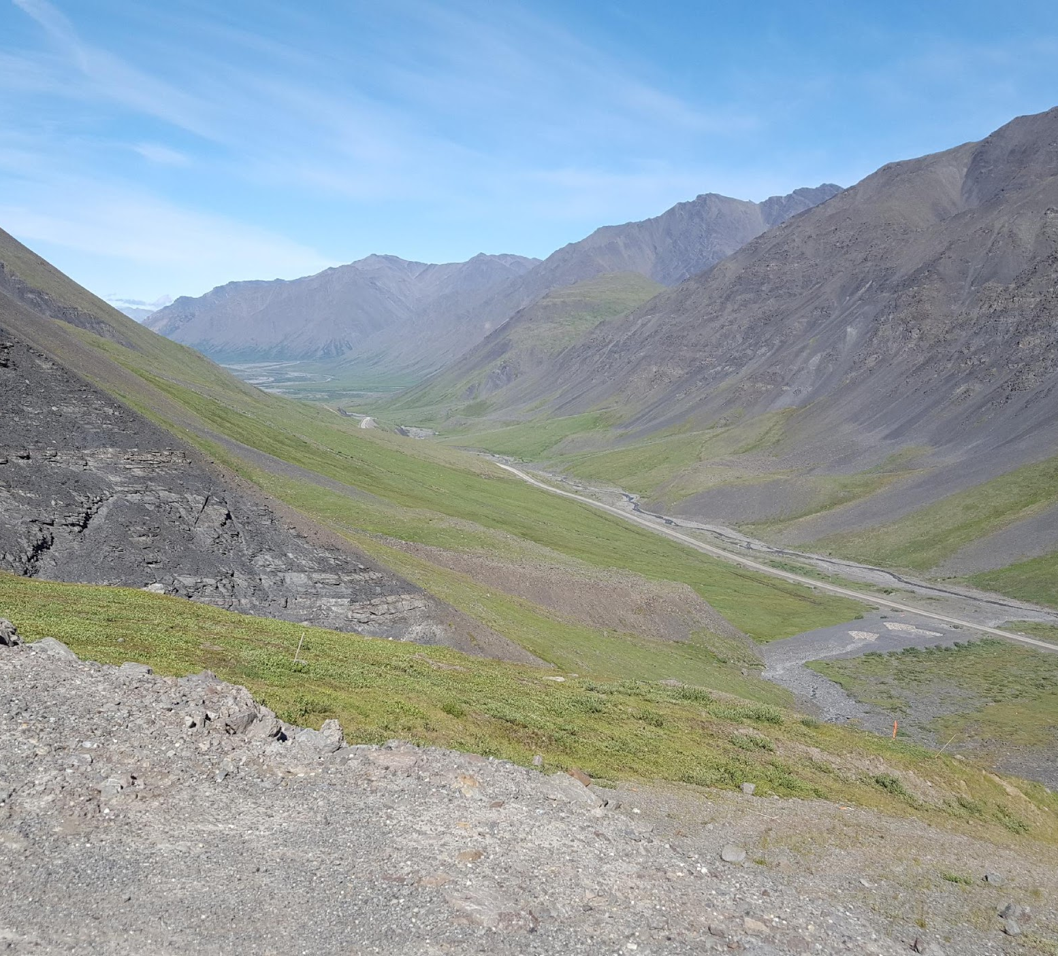
Erosion and Sediment Control Lessons Learned: Challenges to Come
Effluent Guide Limits (EGLs)
Landscape Challenges
Increased Enforcement
Costs

Slide 12
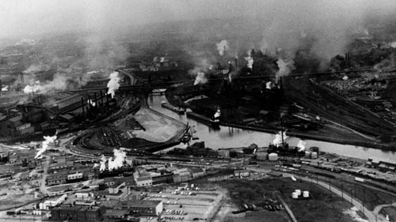
Introduction to the Multi Sector General Permit for Discharges Associated with Industrial Activity
Notes:
Cleveland Ohio, c. 1968

Slide 13
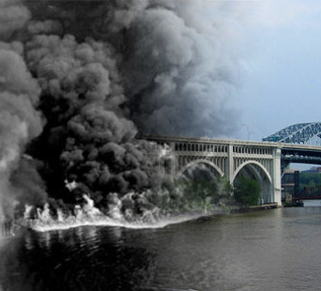
Introduction to the Multi Sector General Permit for Storm Water Discharges Associated with Industrial Activity
Between 1952 and 1968 the Cuyahoga River in Ohio caught fire 13 times and was biologically dead from Akron to Cleveland, some 50 river miles, toxic and anaerobic, and unable to support life. It was more a gutter than a river.
Federal Water Pollution Prevention Act amended in 1972 and became the
“Clean Water Act”.

Slide 14
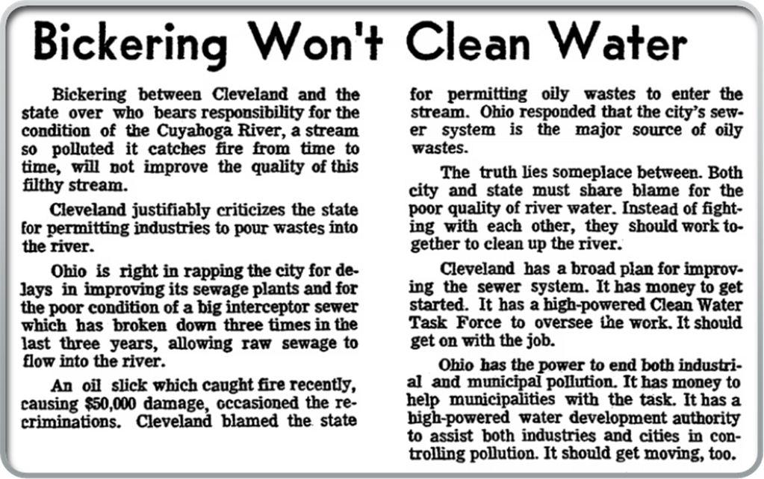
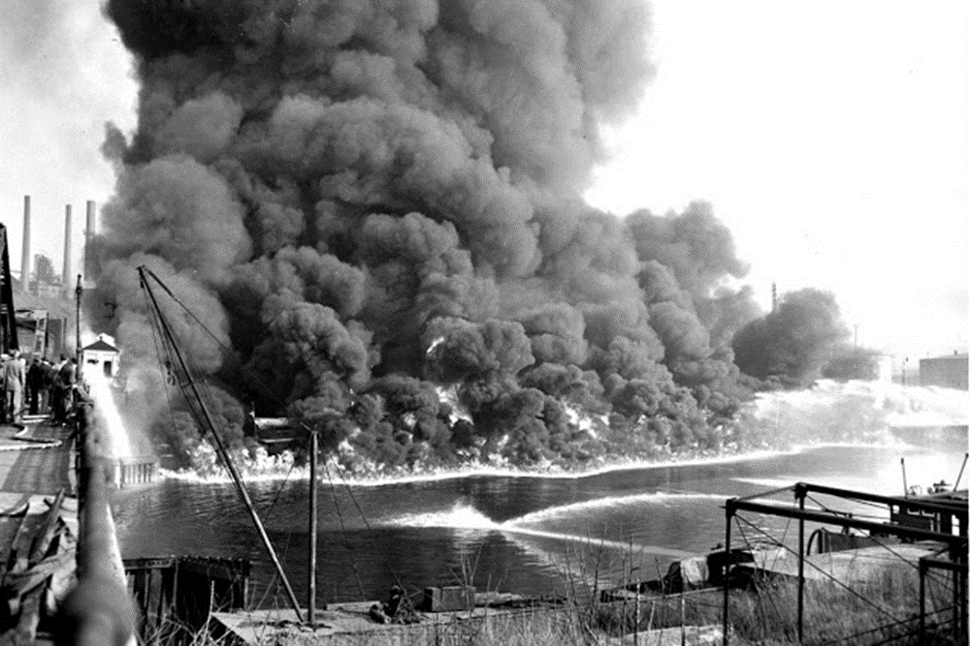

Slide 15
Introduction to the Multi Sector General Permit for Storm Water Discharges Associated with Industrial Activity
The EPA 1990 storm water regulations established National Pollutant Discharge Elimination System ( NPDES) permit requirements for industrial storm water discharges.
EPA issued the first Multi-Sector General Permit (MSGP) for those facilities in 1995. The current MSGP went into effect on June 4, 2015.
Federal regulations at 40 CFR 122.26(b)(14)(i)-(xi) require stormwater discharges associated with specific categories of industrial activity to be covered under NPDES permits (unless otherwise excluded).

Slide 16
11 CATEGORIES OF REGULATED INDUSTRIAL ACTIVITIES
Category One (i): Facilities subject to federal stormwater effluent discharge standards at 40 CFR Parts 405-471
Category Two (ii): Heavy manufacturing
Category Three (iii): Coal and mineral mining and oil and gas exploration and processing
Category Four (iv): Hazardous waste treatment, storage, and disposal facilities
Category Five (v): Landfills, land application sites, and open dumps with industrial wastes
Category Six (vi): Metal scrapyards, salvage yards, automobile junkyards, and battery reclaimers
Category Seven (vii): Steam electric power generating plants
Category Eight (viii): Transportation facilities that have vehicle maintenance, equipment cleaning, or airport deicing operations
Category Nine (ix): Treatment works treating domestic sewage with a design flow of 1 million gallons a day or more
Category Ten (x): Construction sites that disturb 5 acres or more
Category Eleven (xi): Light Manufacturing

Slide 17
Introduction to the Multi Sector General Permit for Storm Water Discharges Associated with Industrial Activity
State of Alaska, Department of Environmental Conservation (DEC) has Primacy for NPDES in Alaska
DEC issued the 2015 Multi-Sector General Permit for Storm Water Discharges Associated with Industrial Activity (2015 MSGP, AKR060000).
§ 1.1 The Alaska Pollutant Discharge Elimination System ( APDES) MSGP covers waters of the United States (U.S.) located in the State of Alaska, except the Indian Reservation of Metlakatla and the Denali National Park and Preserve On February 19, 2015
29 Industrial Sectors

Slide 18
Non-Numeric Technology-Based Effluent Limits
Two types of control measures required by the permit:
General controls that apply to all facilities (MSGP 4.2); and
Sector Specific controls that apply only to specific sectors (MSGP 11).
General Controls Required at all facilities
Minimize Exposure
Good Housekeeping
Maintenance
Spill Prevention and Response Procedure
Erosion and Sediment Controls
Management of Runoff
Salt Storage Piles or Piles Containing Salt
Employee Training
Non Storm Water Discharges
Waste, Garbage, Floatable debris
Dust Generation and Vehicle Track-Out Track-Out

Slide 19
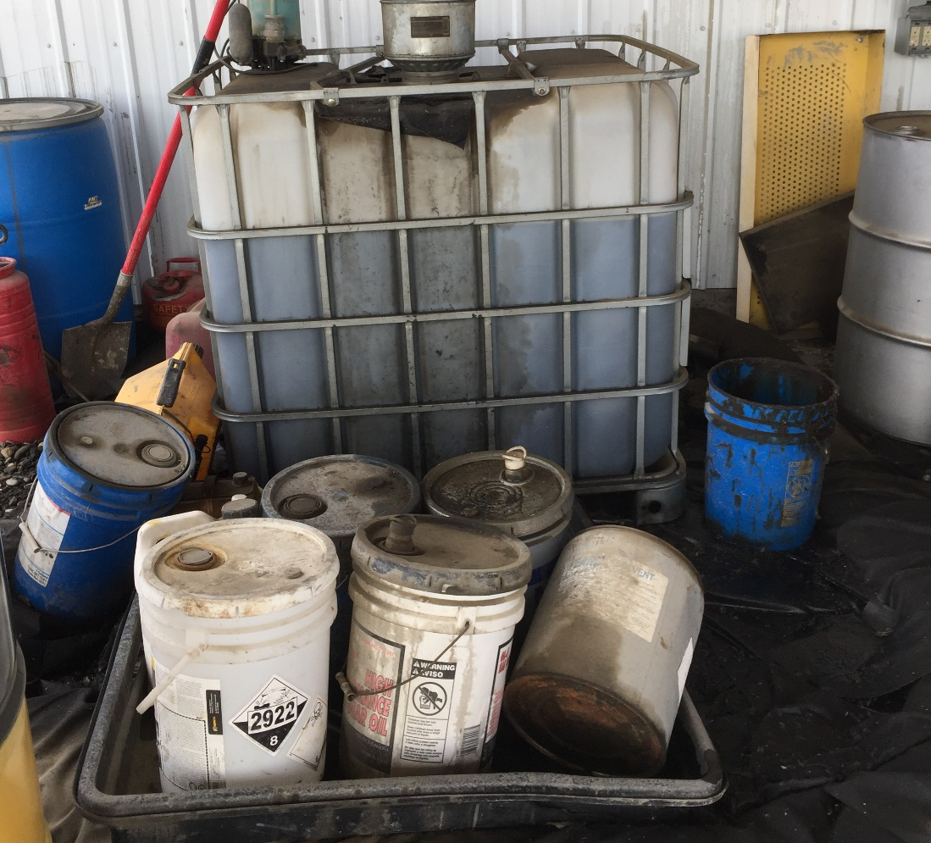
Maintenance Practices
A permittee must regularly inspect, test, maintain, and repair all industrial equipment and systems to avoid situations that may result in leaks, spills, and other releases of pollutants in storm water discharged to receiving waters.
The permittee must maintain all control measures that are used to achieve the effluent limits required by this permit in effective operating condition.
Nonstructural control measures must also be diligently maintained (e.g., spill response supplies available, personnel appropriately trained).
If the permittee finds that their control measures need to be replaced or repaired, the permittee must make the necessary repairs or modifications within 14 days or as expeditiously as practicable.

Slide 20
Spill Prevention and Response
“At a minimum, the permittee must implement:”
Procedures for plainly labeling containers;
Procedures for material storage and handling, including the use of secondary containment and barriers between material storage and traffic areas;
Procedures for expeditiously stopping, containing, and cleaning up leaks, spills, and other releases;
Procedures for notification of appropriate facility personnel, emergency response agencies, and regulatory agencies;
The permittee must provide a description of the release, the circumstances leading to the release, and the date of the release to the nearest DEC Area Response Team Office, in accordance to AS 75.300; and
The permittee must also implement measures to prevent the reoccurrence of such releases and to respond to such releases.
MSGP 4.2.4

Slide 21
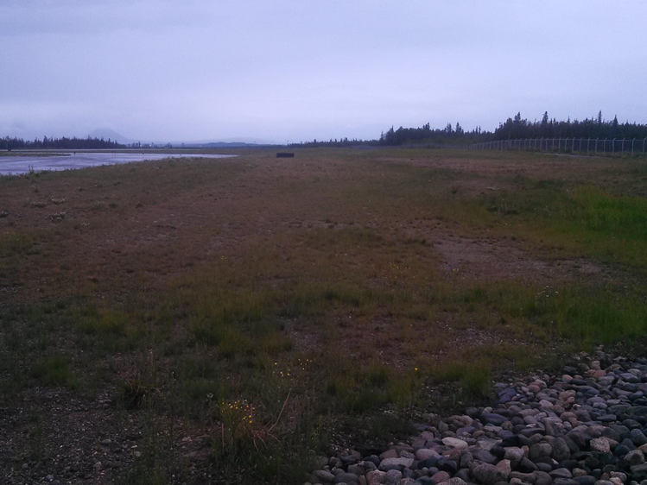
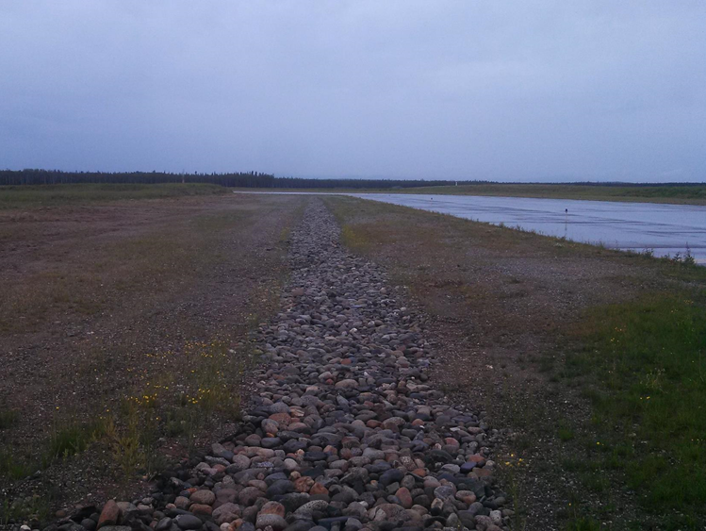
Erosion and Sediment Controls
Exposed areas must be stabilized and runoff contained using structural and/or non structural control measures to minimize onsite erosion and sedimentation, and the resulting discharge of pollutants.
At a minimum, velocity dissipation devices must be placed at discharge locations and within outfall channels where necessary to reduce erosion and/or settle out pollutants.
MSGP 4.2.5

Slide 22
Management of Runoff
MSGP 4.2.6
Storm water runoff must be:
Diverted;
Infiltrated;
Reused;
Contained; or
Otherwise reduced;
to minimize pollutants in a facility’s discharge(s).

Slide 23
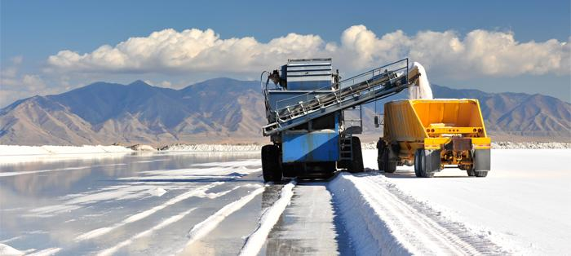
Salt Storage Piles and Piles Containing Salt
MSGP 4.2.7
Storage piles of salt, or piles containing salt, used for deicing or other commercial or industrial purposes, including maintenance of paved surfaces. must be enclosed or covered
Appropriate measures (e.g., good housekeeping, diversions, containment) must also be implemented to minimize exposure resulting from adding to or removing materials from the pile.
http://www.mortonsalt.com/content/images/salt-facts/salt-production-1.jpg?v=1.5

Slide 24
Training of Employees
All employees who work in areas where industrial materials or activities are exposed to storm water, or who are responsible for implementing activities necessary to meet the conditions of this permit must be trained.
Training must cover both the specific control measures used to achieve the effluent limits, monitoring, inspection, planning, reporting, and documentation requirements in other parts of this permit.
Training shall be conducted at least annually and documented in the SWPPP.
http://ak4.picdn.net/shutterstock/videos/2028916/preview/stock-footage-young-people-in-professional-training-on-industrial-site.jpg

Slide 25
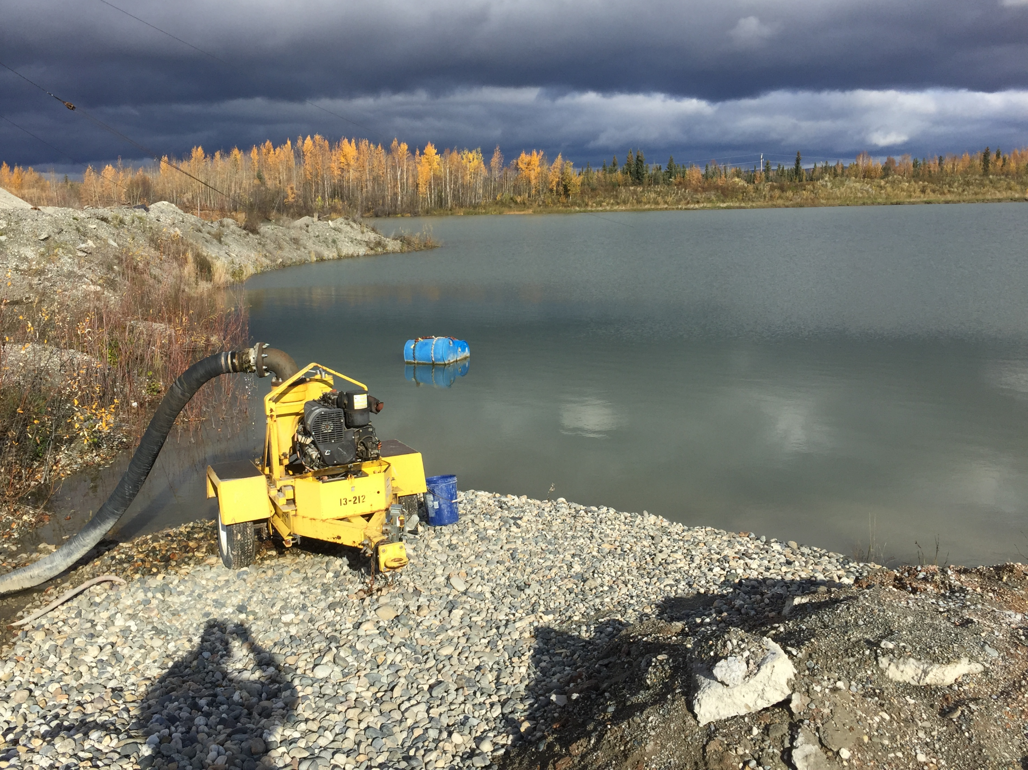
Non-Storm Water Discharges
MSGP 4.2.10, 1.2.3
Authorized Non-Storm Water Discharges:
Discharges from fire-fighting activities;
Fire hydrant flushings;
Potable water, including water line flushings;
Uncontaminated condensate from air conditioners, coolers, and other compressors and from the outside storage of refrigerated gases or liquids;
Irrigation drainage;
Landscape watering provided all pesticides, herbicides, and fertilizer have been applied in accordance with the approved labeling;
Pavement wash waters where no detergents or hazardous cleaning products are used;
Wheel wash water that does not use detergents;
Routine external building wash down / power wash water that does not use detergents or hazardous cleaning products;
Uncontaminated ground water or spring water;
Foundation or footing drains where flows are not contaminated with process materials;
Incidental windblown mist from cooling towers; and
Discharges from the spray down of lumber and wood product storage yards where no chemical additives are used in the spray-down waters and no chemicals are applied to the wood during storage (applicable only to Sector A facilities).
Non-storm water discharges not authorized by an APDES permit must be eliminated
http://www.recycling-nord.com/files/www/gewerbeabfall.png

Slide 26
Waste, Garbage and Floatable Debris
MSGP 4.2.11
Waste, garbage, and floatable debris must not be discharged into receiving waters.
Exposed areas must be kept free of waste, garbage, or floatable debris
OR
Waste, garbage, and floatable debris must be intercepted them before they are discharged.

Slide 27
Dust Generation and Vehicle Tracking of Industrial Materials
MSGP 4.2.12
Dust and offsite tracking of raw, final, or waste materials must be minimized.
Appropriate BMPs to minimize tracking include the establishment of stabilized access and exit points.

Slide 28
MSGP Sector Specific Controls
SECTOR SPECIFIC CONTROLS TAILORED TO INDUSTRIAL SECTOR
QUANTITATIVE MONITORING AND REPORTING
PERMANENT PREFERRED OVER TEMPORARY
EMPHASIS ON DESIGN AND MAINTENANCE
INSPECTIONS/RECORD KEEPING

